Slide 1


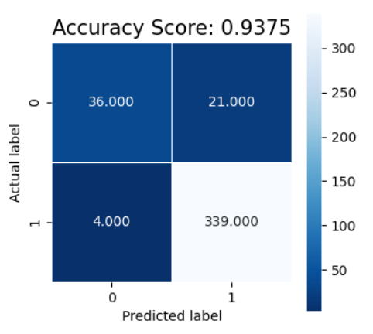
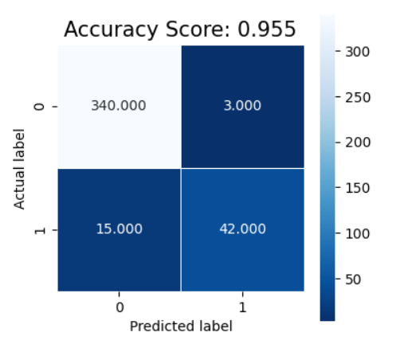
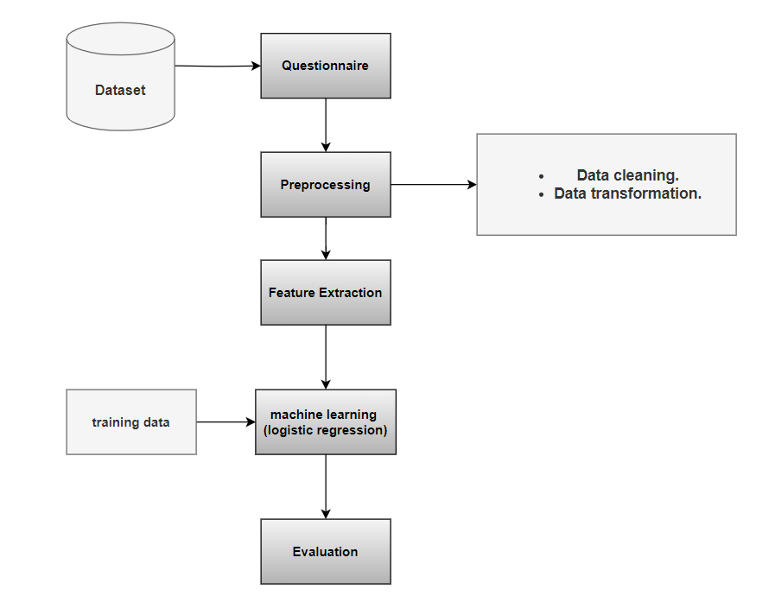
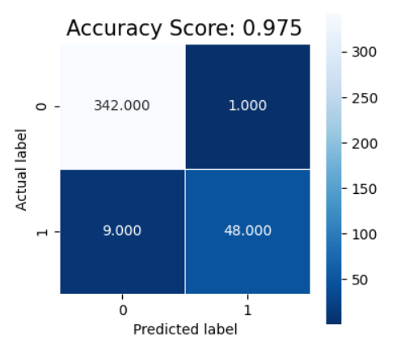
Automatic Risk Assessment of School Violence
By: Mohammed Mostafa Refaat ,Abdelrahman Hassan Mohamed Abdelrahman Rezk Ibrahim ,Raouf Fayek Attia ,Sherif Ahmed El-Sayed
Supervised by: Dr. Naglaa Fathy
Ain Shams University
Faculty of Computer & Information Sciences
Information Systems Department
Introduction
Methods
Results
School violence has a profound and lasting impact on students. It can result in physical injuries, emotional trauma, hindered academic performance, decreased school attendance and engagement, damaged social relationships, long-term effects, and mental health consequences such as anxiety, depression, and low self-esteem.
It is of utmost importance to have an effective system that identifies children who are at risk for exhibiting violent behavior. In this work, we developed a web-based application using machine learning techniques to help parents figure out whether their children are at risk of being violent to their colleagues or not.
Machine learning techniques are employed to automate the risk assessment process for school violence, which is beneficial to:
Reduce school violence.
Maintain safety from school violence.
Help parents figure out whether their children are at risk of being violent to their colleagues or not.
A thorough online questionnaire is prepared, encompassing various risk factors, to assess the risk of violence in adolescents. The questionnaire is constructed based on an interview with a Psychiatrist at Psychiatric Health Resort at Ain Shams University. Risk factors obtained from the interview were organized into categories identified in an earlier study. The key benefit is that the questionnaire is presented in Arabic and English languages to cover a wide range of students from different schools. Data collected from conducted questionnaires are preprocessed to be valid for analysis and classification. Three widely employed machine learning algorithms, namely logistic regression, random forest, and support vector machine (SVM), were applied to the preprocessed data to predict and assess the risk of violence in adolescents. As shown in Figure 1.
We collected about 1400 records from the questionnaire conducted to students. Summary data is shown in Table I. To evaluate the performance of different classification models, the dataset was divided equally into training and testing sets. Logistic regression achieved the highest accuracy at 97.5%, as demonstrated by the confusion matrix in Figure 2. Random forest achieved an accuracy of 93.7%, as shown in the confusion matrix in Figure 3. Support vector machine (SVM) achieved an accuracy of 95.5%, as depicted in the confusion matrix in Figure 4. Both logistic regression and SVM performed well and yielded similar results, surpassing random forest in terms of accuracy. Based on these findings, logistic regression was selected as the preferred model for violence risk assessment classification.
Figure 3 . Confusion Matrix of Random Forest
Figure 4 . Confusion Matrix of Support Vector Machine
Conclusion
In this work, an effective web-based application is developed using machine learning techniques to identify children at risk of exhibiting violent behavior. An online comprehensive questionnaire was created and submitted to students to be used in assessing risk factors associated with potential violence. Results reveal that Logistic Regression achieved the highest accuracy of 97.5% for automated risk assessment. The reason for having logistic regression with the highest accuracy because the relationship between the features and the outcome is linear.
The current system has a few drawbacks that could potentially have fixes in the future:
1) Detecting the risks of violence among young people, not only for children.
Detecting the risks of violence against oneself.
To improve the interaction and engagement with the child, the system could consider using indirect questions that are more child-friendly. Instead of directly asking about risks of violence, the system can frame questions in a more subtle and playful manner.
Question | Percentage
Gender | 51.6%- Male 49% -Female
Age | 27.2% of individuals belong to the age group of 11-13 years. 30.6% of individuals belong to the age group of 14-16 years. 42.2% of individuals belong to the age group of 17-19 years.
Do you feel happy when others suffer? | 44.6% -Yes 55.4% -No
Do you prefer games that are based on violence? | 50.4% -Yes 49.6% -No
Do you have severe emotional outbursts? | 53.6% -Yes 46.4% -No
Do you bully others physically or online? | 46.1%-Yes 53.9%-No
Do you feel angry or lose your temper often? | 50.1%-Yes 49.9%-No
When you get into a fight, what do you use? | 29.5%-use brick or stone 29.8-use white weapons such as knife 40.7%-use your power
Have you ever been cruel to an animal? | 41.4%-Yes 58.6%-No
Are your parents wanted by the police or have they committed a crime before? | 45.4%-Yes 54.6%-No
Any of these actions you have done before or are still doing? Trespassing School Escape Threatening Your Colleagues You have physical injuries from fights You're hitting your Colleagues or others in fights Frequent refusal to command parents or others in authority Drug abuse, cigarettes, hookah or drinking alcohol | 47.5%-Yes 52.5%-No
What would you do if you witnessed someone being abused? | 54.7%-you will help him/her 45.3%-you will ignore him/her
What is your parental education level? (either of them)? | 22.3%-uneducated 30.5%-at least one of parent have a university education 24.4%- both parents have high school diploma 22.8%-parents have less than high school diploma
Did your father lose his job sometime for a long time? | 45.8% -Yes 54.2% -No
Is there a family member addicted to alcohol or drugs? | 44.8% -Yes 55.2% -No
References
Table I . Requirement gathering technique
[1] Fast Fact: Preventing School Violence |Violence Prevention|Injury Center|CDC. (n.d.).https://www.cdc.gov/violenceprevention/youthviolence/schoolviolence/fastfact.html
[2] Press Release - New NCES Data Show Increases in School Shootings and Cyberbullying in K–12 Schools Over the Last Decade - June 28, 2022. (n.d.). https://nces.ed.gov/whatsnew/press_releases/06_28_2022.asp.
[3] Mroczkowski, M. M., Walkup, J. T., & Appelbaum, P. S. (2021). Assessing Violence Risk in Adolescents in the Pediatric Emergency Department: Systematic Review and Clinical Guidance. Western Journal of Emergency Medicine, 22(3). https://doi.org/10.5811/westjem.2021.1.49233
[4] Henry, Stuart. "What is school violence? An integrated definition." The annals of the American academy of political and social science 567.1 (2000): 16-29.
[5] Garaigordobil, Maite, and Vanesa Martínez-Valderrey. "Impact of Cyberprogram 2.0 on different types of school violence and aggressiveness." Frontiers in psychology 7 (2016): 428.
[6] Chen, Ji-Kang, and Hsi-Sheng Wei. "The impact of school violence on self-esteem and depression among Taiwanese junior high school students." Social indicators research 100 (2011): 479-498
Figure 1 . Methods and Procedures Used
Figure 2 . Confusion Matrix of Logistic Regression

